Slide 1
Intersection of Sports Science & Game Performance
Benchmarking Women’s Basketball Performance
Jade Gosar & Ethan Aslami

Slide 2
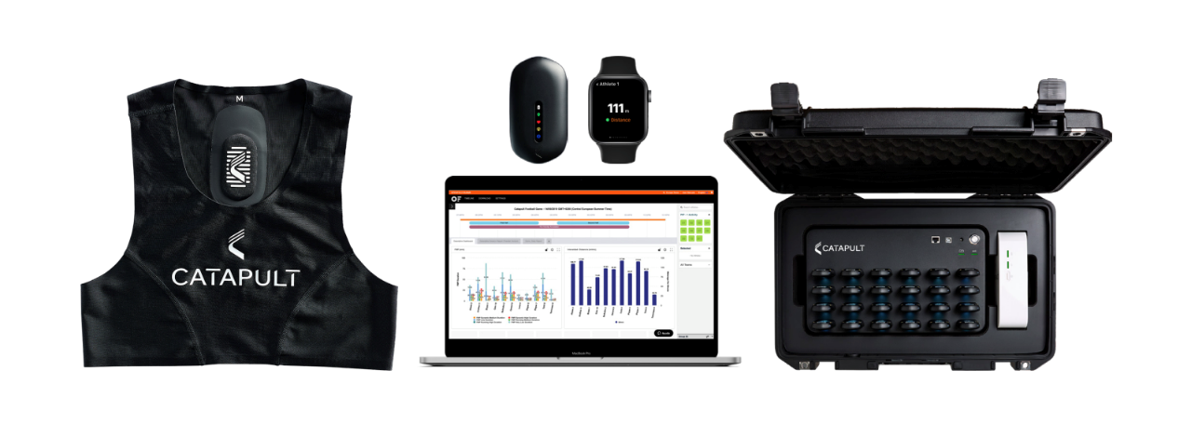
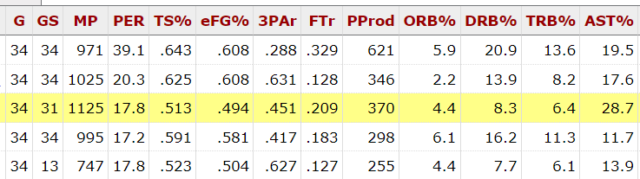
Initial Questions
How can we leverage sports science data to enhance gameday box score performance?
Exploring the impact of linking sports science data with game performance
What insights can we derive from the relationship between gameday statistics and the training load leading up to a game?
Informs decisions for practices during game-weeks
Introduction
Initial Models
Team Analysis
Team Performance
Catapult Analysis
Results/Findings

Slide 3
Data Sources
Performance Analysis
Smartbox
Force Plate
Sports Reference
Catapult
Smartbox: Team specific box score statistics
Sports Reference: Popular public box score statistics database
Catapult: Data from player worn catapult units including accelerations, decelerations, and player workload from practices
Force plate: Weekly athlete jump testing for force, power, and fatigue using Vald Forcedecks
Introduction
Initial Models
Team Analysis
Team Performance
Catapult Analysis
Results/Findings

Slide 4
Creation of Over/Underperformance Metric
Why did we need it?
Only Using Game outcome (W vs L) is limited
Find improvements, even after wins
Even wins for high-performing teams can be underperformances based on specific stats.
Introduction
Initial Models
Team Analysis
Team Performance
Catapult Analysis
Results/Findings

Slide 5

Logistic Regression Model on Wins and Losses
Sports Reference stats from AP Top 25 and Pac12 teams containing:
Pace, 3 Point Attempt rate (3PAr) , Assist %, Both team’s Effective Field Goal % (EFG%), Offensive Rebounding % (ORB%) and Defensive Rebounding % (DRB%) among others
Removed highly correlated metrics
Used NCAA’s NET Ranking system to account for strength of schedule
Introduction
Initial Models
Team Analysis
Team Performance
Catapult Analysis
Results/Findings

Slide 6
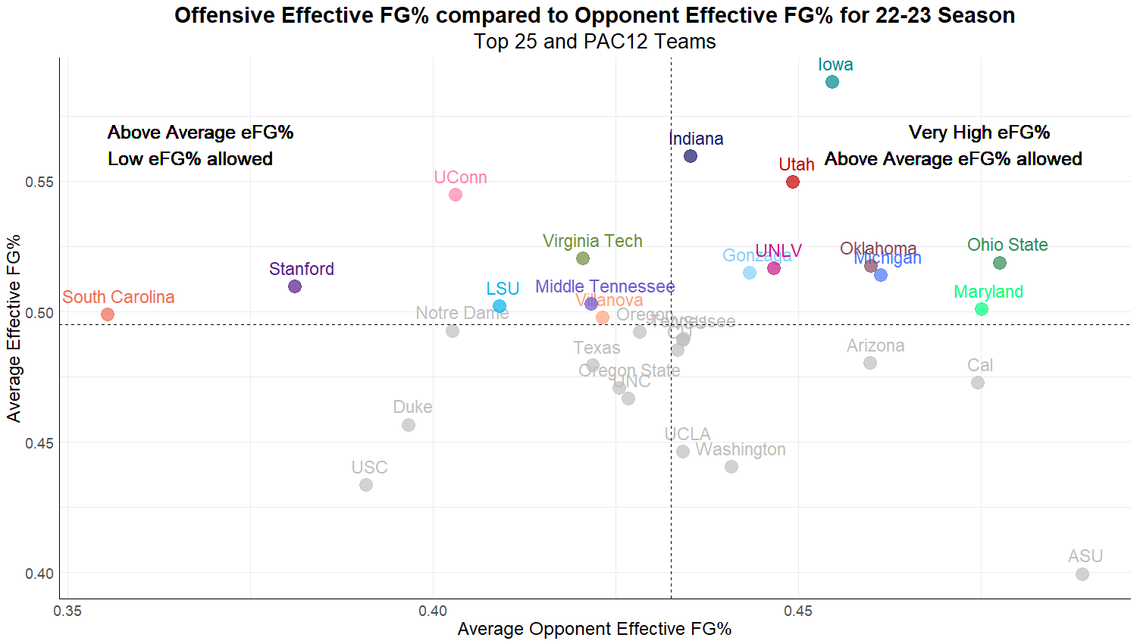
Initial Analysis
Introduction
Initial Models
Team Analysis
Team Performance
Catapult Analysis
Results/Findings

Slide 7
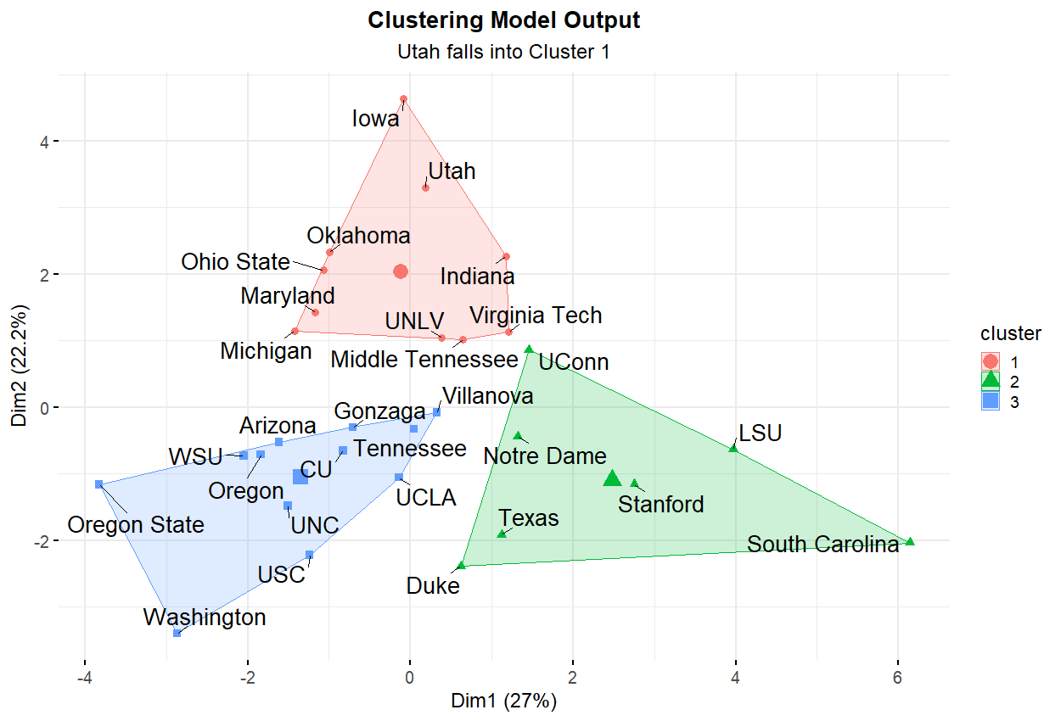
Cluster Analysis
Wanted to see if significant metrics that influenced wins and losses changed if only teams that played similar styles to team of interest were considered
Introduction
Initial Models
Team Analysis
Team Performance
Catapult Analysis
Results/Findings
Notes:
If teams are split into groups according to their style of play different statistics become more important as determinants of success

Slide 8
Cluster Analysis Differences
Last season our cluster tended to:
Play at a faster pace
Perform very well in offensive metrics such as EFG%, assist percentage, and shooting more free throws
Have a much higher three-point attempt rate
Low offensive rebound percentage, highest EFG% allowed by opponents
Our 23-24 team fell into a similar cluster but with different characteristics:
Played at a slower pace
Better in defensive metrics such as opponent Effective Field Goal % and giving up less free throws
Shot significantly less free throws
Shot less 3 pointers and turned over the ball slightly more
Much higher defense rebound percentage
Introduction
Initial Models
Team Analysis
Team Performance
Catapult Analysis
Results/Findings
Notes:
Our 23-24 team fell into a cluster that could still be classified as high-performing offensive teams but with different characteristics:

Slide 9

Logistic Regression Model Comparisons
Purpose
Identify teams with similar playstyles to us to determine metrics that were most important
Results
Multiple regressions, one on all top performing teams and one on group of similar teams
Compared model accuracy at predicting team success to see metrics that were statistically significant in determining game outcome
Introduction
Initial Models
Team Analysis
Team Performance
Catapult Analysis
Results/Findings
Notes:
Now that we had identified the teams with similar playstyles as us, we needed to find out which metrics were most important to us
We compared the models on how accurate they were at determining team success to see which metrics proved to be statistically significant in determining game outcome.

Slide 10
Metrics that were Important to our Cluster’s Success
Ordered by magnitude of influence on game outcomes
22-23 Season
23-24 Season
Effective Field Goal %
Opponent Effective Field Goal %
Steal %
Turnover %
3 Point Attempt Rate
Offensive/Defensive Rebound %
Opponent Free Throws per Field Goal Attempt
Free Throws per Field Goal Attempt
Accuracy: 92%
Effective Field Goal %
Opponent Effective Field Goal %
Free Throws per Field Goal Attempt
Opponent Free Throws per Field Goal Attempt
Turnover %
Steal %
Offensive/Defensive Rebound %
Assist %
Accuracy: 95%
More important to other teams
More important to Team of Interest
Introduction
Initial Models
Team Analysis
Team Performance
Catapult Analysis
Results/Findings
Notes:
Personnel and availability

Slide 11
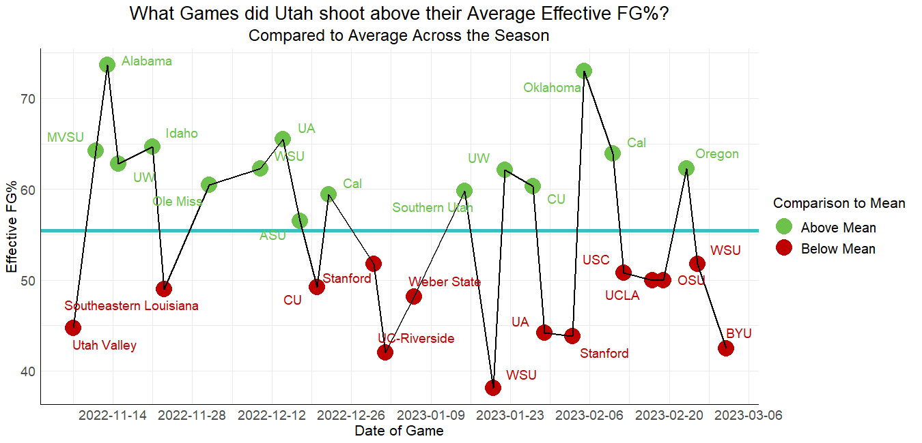
Creation of Over and Underperformance Metric
Looked into every game for each statistic and compared the individual game value to the season average
Introduction
Initial Models
Team Analysis
Team Performance
Catapult Analysis
Results/Findings

Slide 12
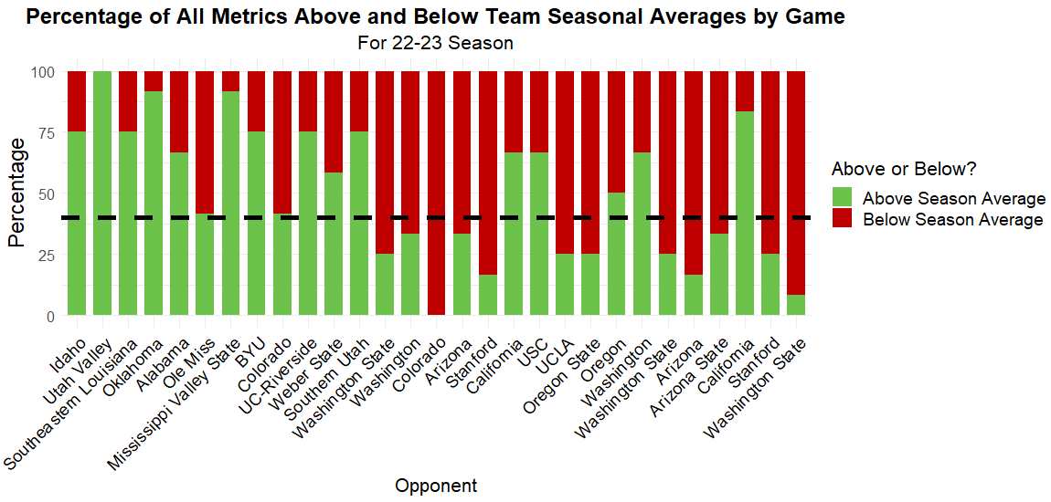
How Over / Underperformance Metric was created
If over 40% of metrics surpassed the season average, it was labeled an overperformance
If under 40% of metrics exceeded the season average, it was labeled an underperformance.
Introduction
Initial Models
Team Analysis
Team Performance
Catapult Analysis
Results/Findings

Slide 13
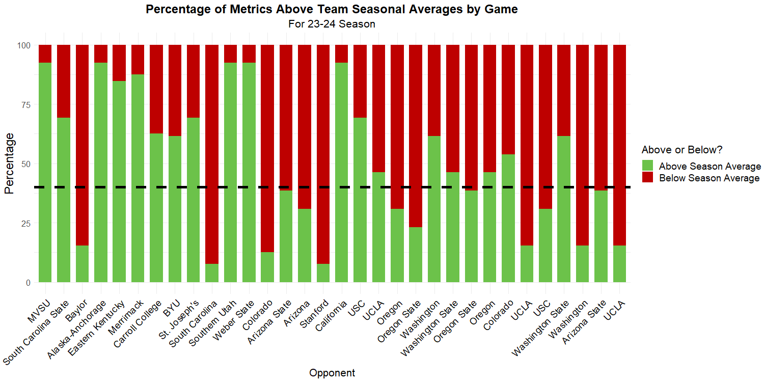
23-24 Performance Metric
Introduction
Initial Models
Team Analysis
Team Performance
Catapult Analysis
Results/Findings

Slide 14
Considerations
Data Limitations
GD-2 metrics could not be used in final model as not all games had a GD-2 practice
Preseason and NCAA tournament games were not included
Athlete injuries across the season that caused changes in catapult team metrics were not accounted for in the scope of this analysis
Only players who played significant minutes were included in catapult analysis
Analysis Considerations
In an applied setting, we face limitations compared to lab settings due to the multitude of uncontrolled variables.
We relaxed the traditional statistical significance level of 95% to 80%
Introduction
Initial Models
Team Analysis
Team Performance
Catapult Analysis
Results/Findings
Notes:
Preseason and NCAA tournament games were not included as there were no SmartBox stats available for these games

Slide 15
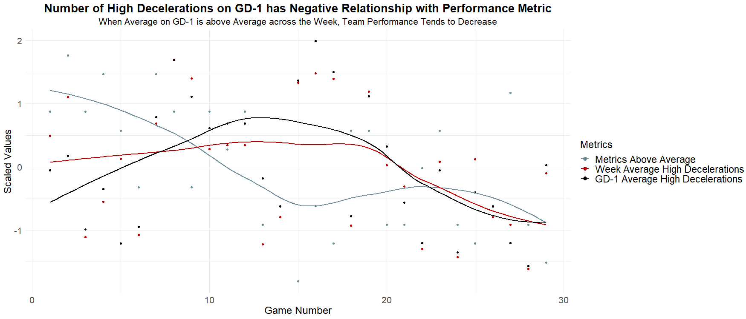
Team Catapult Analysis Results
Introduction
Initial Models
Team Analysis
Team Performance
Catapult Analysis
Results/Findings

Slide 16
Results and Findings
GD-1
High Decelerations, perf
All Practices
Medium Accelerations, perf
Load per Minute, perf
Total Load, perf
% High Decelerations, perf
High Decelerations, perf
Session Duration, perf
% High Decelerations, perf
Medium Accelerations, perf
High Accelerations, perf
Load per Minute, perf
Significant last season
Significant this season
Significant both seasons
Introduction
Initial Models
Team Analysis
Team Performance
Catapult Analysis
Results/Findings

Slide 17
Applications
If the average number of medium accelerations on GD-1 is greater than the average medium accelerations across all practices, performance tends to decrease
Medium Accelerations had statistically significant relationship with in-game performance both years
Analyze drills ran frequently in practices
Introduction
Initial Models
Team Analysis
Team Performance
Catapult Analysis
Results/Findings
Notes:
If the average number of medium accelerations on GD-1 is greater than the average medium accelerations across all practices, performance tends to decrease
Medium Accelerations over the week was statistically significant relationship
Identify specific drills to find those that produce the most accelerations and decelerations

Slide 18
Potential Future Analysis
Individual Analysis
With the availability of multiple years of data, personalize results further to individuals and position groups
Apply team analysis steps to identify players who exhibit similar or divergent trends in performance metrics compared to the team
Force Plates
Incorporate consistent force plate testing data from multiple seasons into the final model
Introduction
Initial Models
Team Analysis
Team Performance
Catapult Analysis
Results/Findings

Slide 19
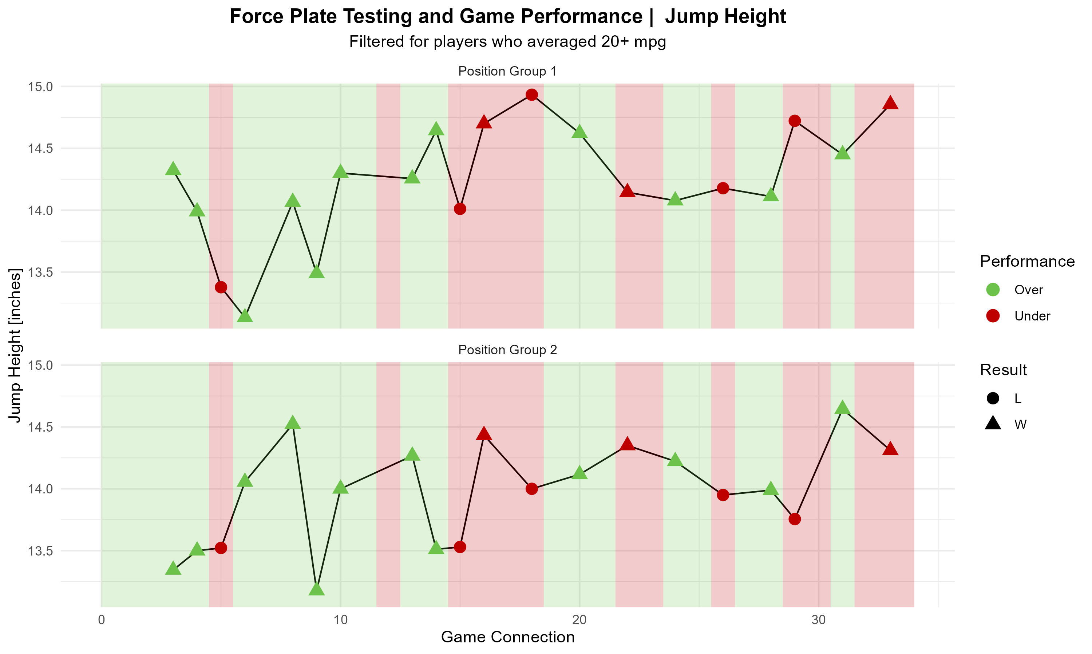
Potential Future Analysis
Introduction
Initial Models
Team Analysis
Team Performance
Catapult Analysis
Results/Findings

Slide 20
Conclusions
Sports Science data can be utilized in informing decision making that can positively impact game day performance
College Sports are increasingly susceptible to changing personnel each year and even small changes can have drastic impacts on how a practice looks and how the team performs
Personalizing analysis leads to more impactful and specific findings for potential implementation
Introduction
Initial Models
Team Analysis
Team Performance
Catapult Analysis
Results/Findings

Slide 21
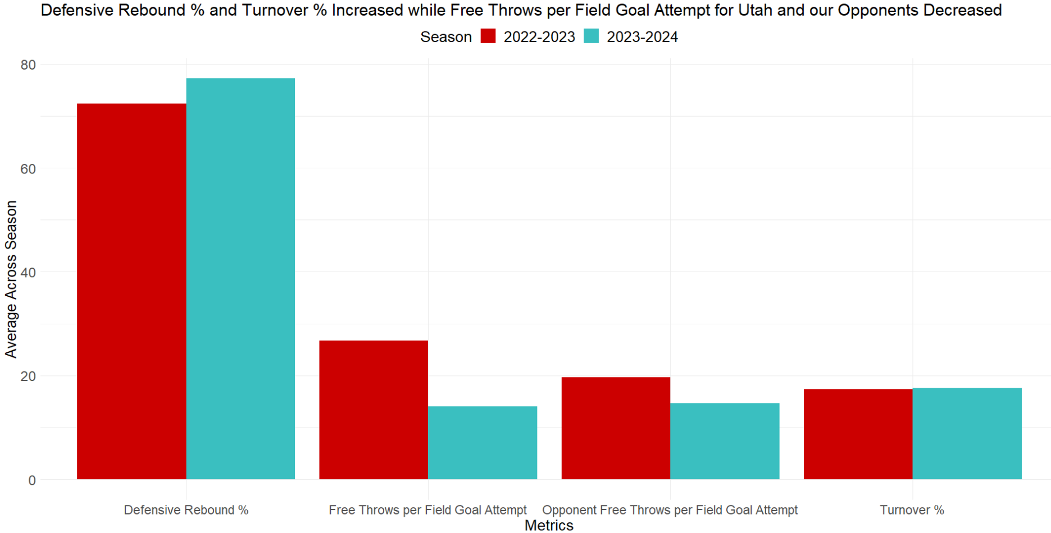
Important Metric Differences between Seasons
Introduction
Initial Models
Team Analysis
Team Performance
Catapult Analysis
Results/Findings

Slide 22
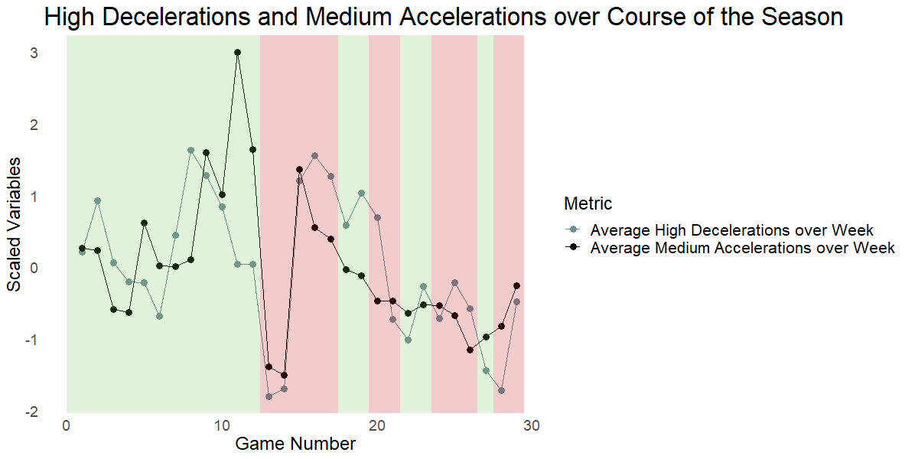
Team Catapult Analysis Results
Introduction
Initial Models
Team Analysis
Team Performance
Catapult Analysis
Results/Findings

Slide 23
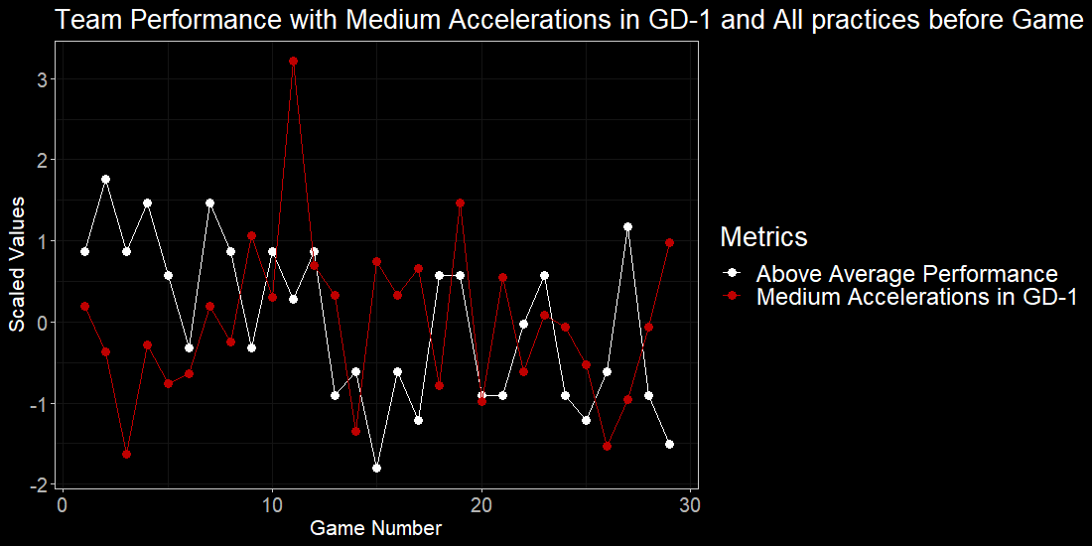
Team Catapult Analysis Results
Introduction
Initial Models
Team Analysis
Team Performance
Catapult Analysis
Results/Findings

Slide 24
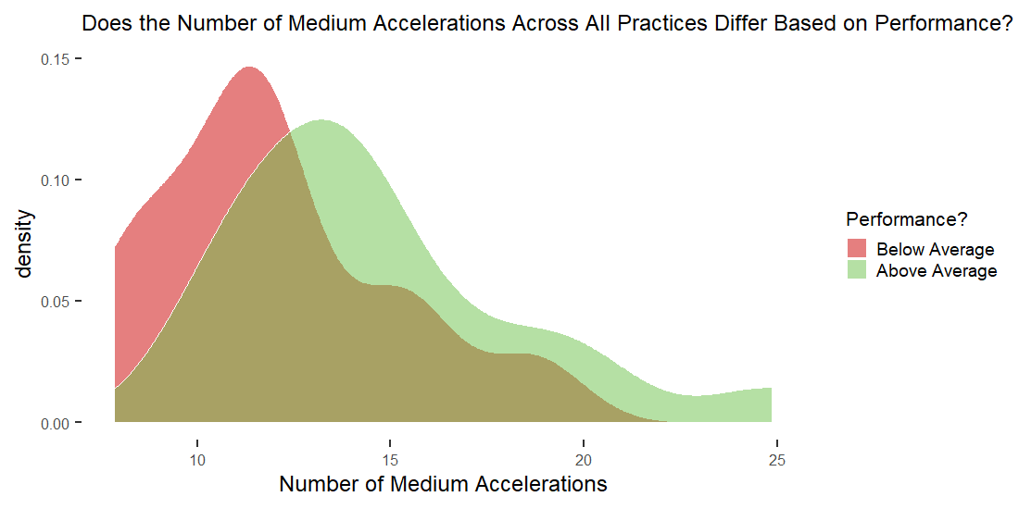
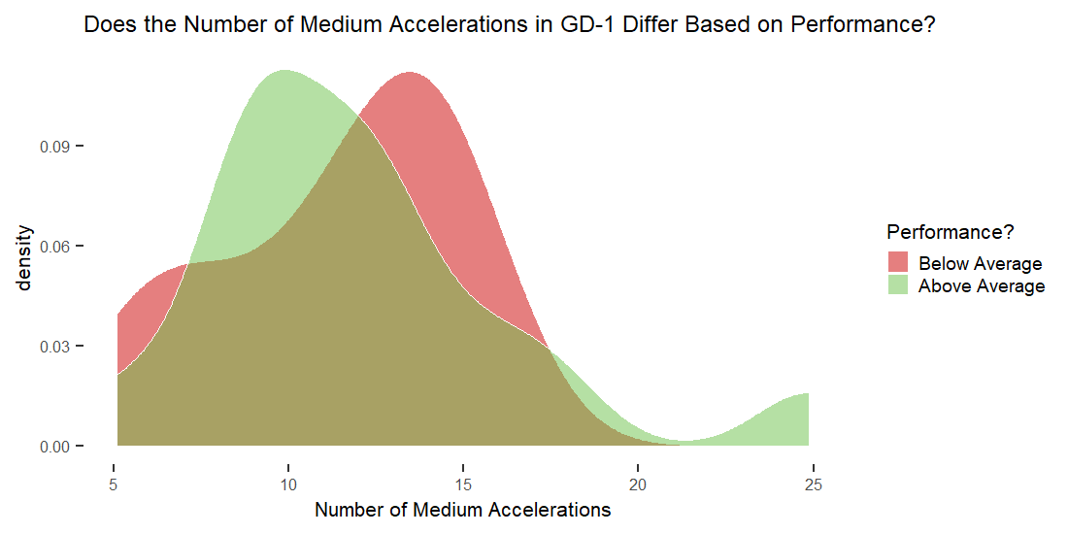
Metric Differences
Introduction
Initial Models
Team Analysis
Team Performance
Catapult Analysis
Results/Findings

